Slide 1
Quanvolutional Neural Networks
for Deepfake Detection
Hannah Graff
DSC 599: Data Science Senior Capstone
2 December 2024

Slide 2
Introduction
Quanvolutional Neural Networks

Slide 3
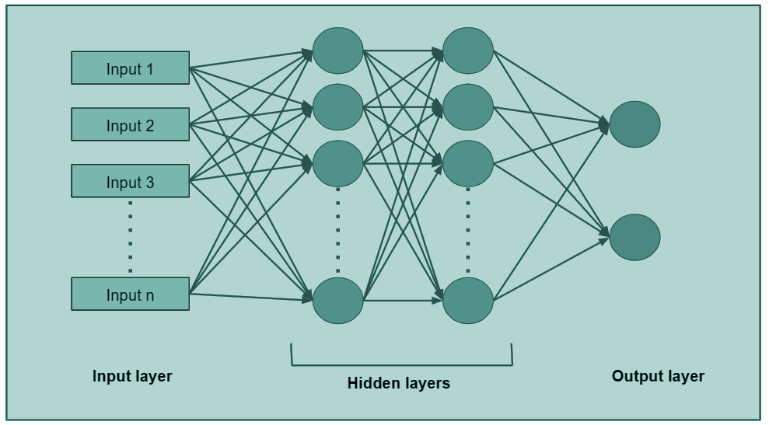
Convolutional Neural Networks
Convolutional Neural Networks (CNNs):
neural networks used for (image) classification using (1) a convolutional layer, (2) a pooling layer, and (3) a fully-connected (FC) layer
Notes:
Convolutional layer: hidden functions extracting features (requires input data, a filter, and a feature map)
Pooling: reduce dimension by deleting some information
Fully-connected: classification
ReLu: changed linear function so that negative values become zero

Slide 4
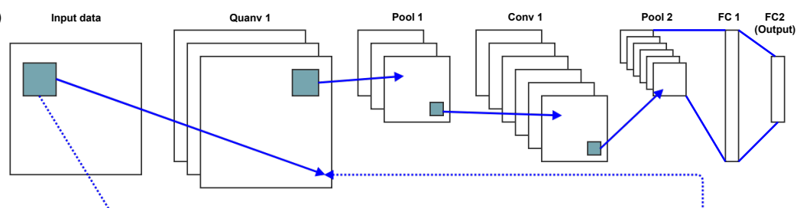
Quanvolutional Neural Networks
Quanvolutional Neural Network:
built on the CNN; instead of convolutional layers, quanvolutional layers transform the data using a number of random quantum circuits
Notes:
Images from paper: https://arxiv.org/pdf/1904.04767

Slide 5
Quanvolutional Neural Networks
Quanvolutional Neural Network:
built on the CNN; instead of convolutional layers, quanvolutional layers transform the data using a number of random quantum circuits
For more info, refer to “Quanvolutional Neural Networks: Powering Image Recognition with Quantum Circuits” by Henderson et. al
Notes:
Images from paper: https://arxiv.org/pdf/1904.04767

Slide 6
Literature Review (Data Science)
“Quanvolutional Neural Networks: Powering
Image Recognition with Quantum Circuits”
Maxwell Henderson, Samriddhi Shaky, Shashindra Pradhan, and Tristan Cook
Dataset: MNIST dataset (70,000 28x28 greyscale pixel images.)
Methodology:
Split data 60,000/10,000 for training/testing
Define QNN filter
Encode and decode
Implement CNN, QNN, and Random model
Limitations:
QNN Limitations (e.g., large # of transformations)
“a massive number of practical questions need further research to bring the QNN functionality to its peak performance”
Notes:
https://arxiv.org/pdf/1904.04767

Slide 7
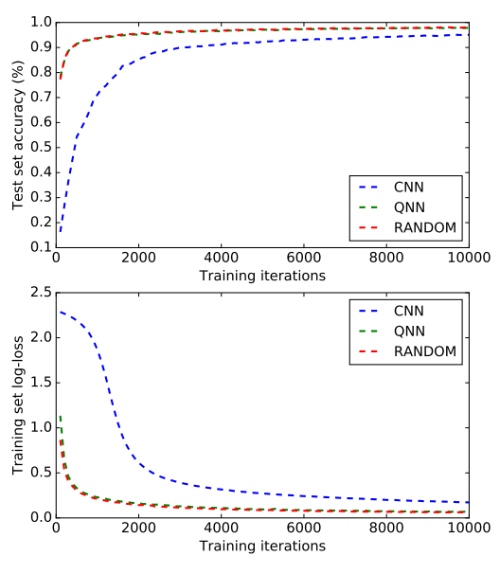
Literature Review (Data Science)
“Quanvolutional Neural Networks: Powering
Image Recognition with Quantum Circuits”
Maxwell Henderson, Samriddhi Shaky, Shashindra Pradhan, and Tristan Cook
Notes:
https://arxiv.org/pdf/1904.04767

Slide 8
Introduction
Deepfakes

Slide 9


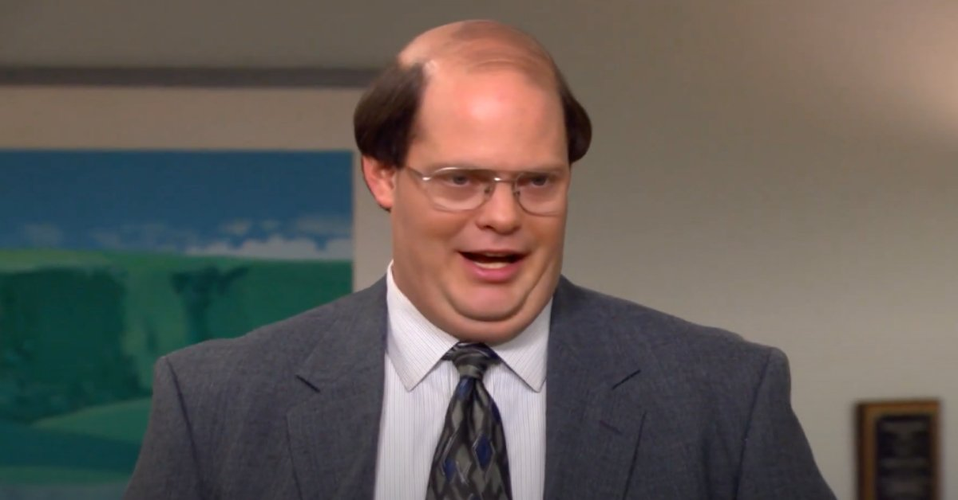
Deepfake Examples

Slide 10
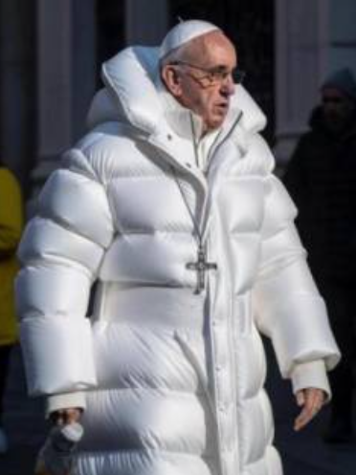
Deepfakes
Deepfake: artificially generated photo of a person
Deepfakes can create many problems, including:
Identity theft
Cyberbullying
Including pornographic content
Fake news dissemination
Threats to global security

Slide 11
Deepfakes
Deepfake: artificially generated photo of a person
Deepfakes can create many problems, including:
Identity theft
Cyberbullying
Including pornographic content
Fake news dissemination
Threats to global security
For more info, refer to “Detecting Deepfake Videos Using Attribution-Based Confidence Metric” by Fernandes et. al

Slide 12
Literature Review (Deepfakes)
“Detecting Deepfake Videos Using
Attribution-Based Confidence Metric”
Steven Fernandes, Sunny Raj, Rickard Ewetz, Jodh Singh Pannu, Sumit Kumar Jha, Eddy Ortiz, Iustina Vintila, Margaret Salter
Datasets: 3 original & 3 generated
Original: 2 from COHFACE and VidTIMIT datasets and 1 from YouTube.
Generated: 2 videos from COHFACE dataset and YouTube using a commercial website, and 1 using GANs
Combine original and donor video
Methodology:
Create/find the datasets
Apply the ABC-metric
Obtain cumulative data fraction and ABC plots
Notes:
https://openaccess.thecvf.com/content_CVPRW_2020/papers/w19/Fernandes_Detecting_Deepfake_Videos_Using_Attribution-Based_Confidence_Metric_CVPRW_2020_paper.pdf

Slide 13
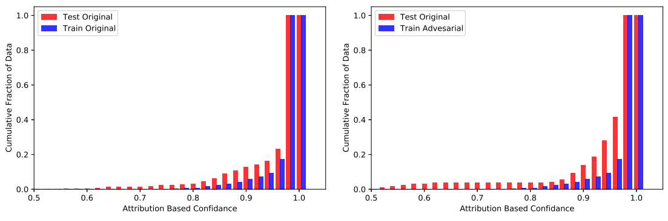
Literature Review (Deepfakes)
“Detecting Deepfake Videos Using
Attribution-Based Confidence Metric”
Steven Fernandes, Sunny Raj, Rickard Ewetz, Jodh Singh Pannu, Sumit Kumar Jha, Eddy Ortiz, Iustina Vintila, Margaret Salter
Limitations: None listed
Notes:
https://openaccess.thecvf.com/content_CVPRW_2020/papers/w19/Fernandes_Detecting_Deepfake_Videos_Using_Attribution-Based_Confidence_Metric_CVPRW_2020_paper.pdf

Slide 14
Objectives

Slide 15
Project Goal
Deepfakes
QNNs

Slide 16
Project Goal
Deepfakes
QNNs
Implement a quanvolutional neural network (QCNN) model for deepfake detection

Slide 17
Project Objectives
advance the study and implementation of quantum computing via Quanvolutional Neural Networks
outpace the growth of AI deepfake creation with the abilities of deepfake detection
enhance processing efficiency
propose a viable option for combating deepfake detection

Slide 18
Overview

Slide 19
Process
Generate data
Preprocess models
Train data on CNN & QNN
Generate new data
Test data on CNN & QNN

Slide 20
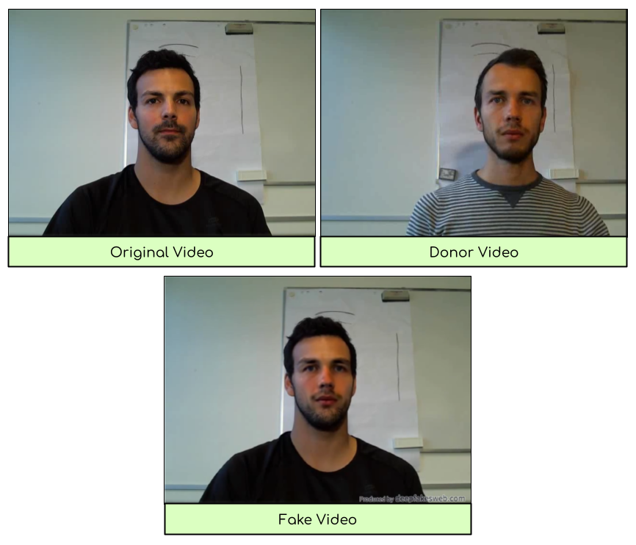
Generate Data
Generate data
Preprocess models
Train data on CNN & QNN
Generate new data
Test data on CNN & QNN
Developed with https://deepfakesweb.com/
Combine real video with donor to get fake video
10 real, 10 fake

Slide 21
Preprocess Models
Generate data
Preprocess models
Train data on CNN & QNN
Generate new data
Test data on CNN & QNN
%matplotlib inline
!pip install pennylane
!pip install seaborn # Install the Seaborn library
import seaborn as sns
import pennylane as qml
from pennylane import numpy as np
from pennylane.templates import RandomLayers
import tensorflow as tf
from tensorflow import keras
import matplotlib.pyplot as plt
Requirements:
Python 3.10
Pennylane, Seaborn library
Pennylane: process quantum computers
Seaborn: statistical visualization

Slide 22
Preprocess Models
Generate data
Preprocess models
Train data on CNN & QNN
Generate new data
Test data on CNN & QNN
@qml.qnode(dev)
def circuit(phi):
# Encoding of 2 classical input values (could be features from your images)
for j in range(2):
qml.RY(np.pi * phi[j], wires=j)
# Random quantum circuit
for layer in range(n_layers):
qml.templates.layers.RandomLayers (weights=rand_params[layer], wires=list(range(2)))
# Measurement producing 2 classical output values
return [qml.expval(qml.PauliZ(j)) for j in range(2)]
Preprocess model:
Define epochs, layers, validation split
Define a circuit
Convolve input images with quantum circuit
100 fake/real from training/testing dataset

Slide 23
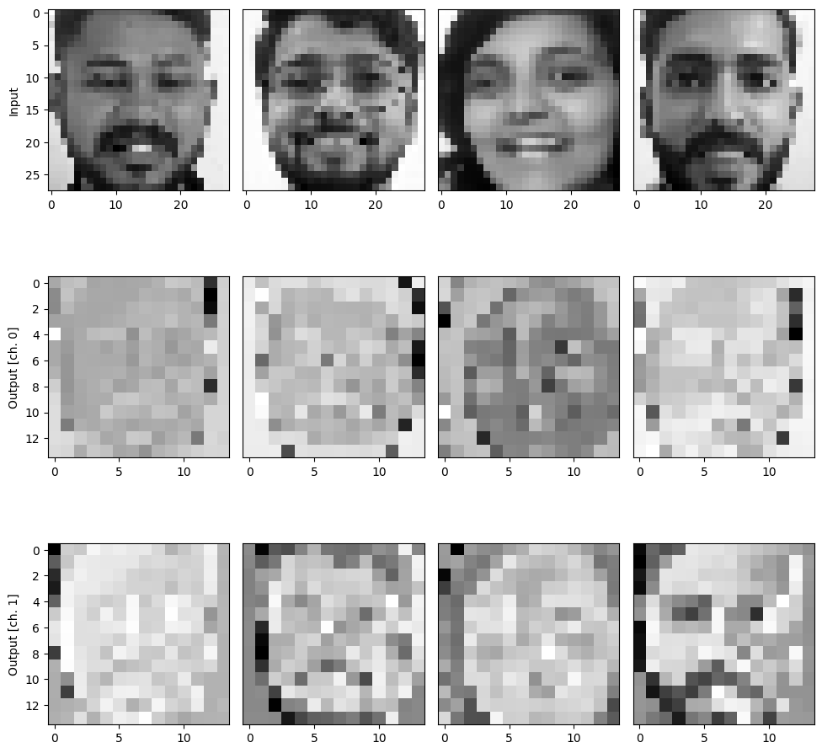
Preprocess Models
Generate data
Preprocess models
Train data on CNN & QNN
Generate new data
Test data on CNN & QNN

Slide 24
Train Data on CNN & QNN
Generate data
Preprocess models
Train data on CNN & QNN
Generate new data
Test data on CNN & QNN
def MyModel():
"""Initializes and returns a custom Keras model for classical images."""
model = keras.models.Sequential([
keras.layers.Flatten(input_shape=(28, 28, 1)), # Input shape for 28x28 grayscale images
keras.layers.Dense(64, activation="relu", input_shape=(784,)), # Hidden layer
keras.layers.Dense(1, activation="sigmoid") # Output layer for binary classification
])
model.compile(
optimizer='adam',
loss="binary_crossentropy", # Binary cross-entropy for binary classification
metrics=["accuracy"],
)
return model

Slide 25
Train Data on CNN & QNN
Generate data
Preprocess models
Train data on CNN & QNN
Generate new data
Test data on CNN & QNN
def MyModel():
"""Initializes and returns a custom Keras model which is ready to be trained."""
model = keras.models.Sequential([
keras.layers.Input(shape=(14, 14, 2)), # Input shape matches the output of quanv
keras.layers.Flatten(), # Flatten the input from (14, 14, 2) to (392,)
keras.layers.Dense(16, activation="relu"), # Hidden layer
keras.layers.Dense(1, activation="sigmoid") # Output layer for binary classification
])
model.compile(
optimizer='adam',
loss="binary_crossentropy", # Use binary cross-entropy for binary classification
metrics=["accuracy"],
)
return model

Slide 26
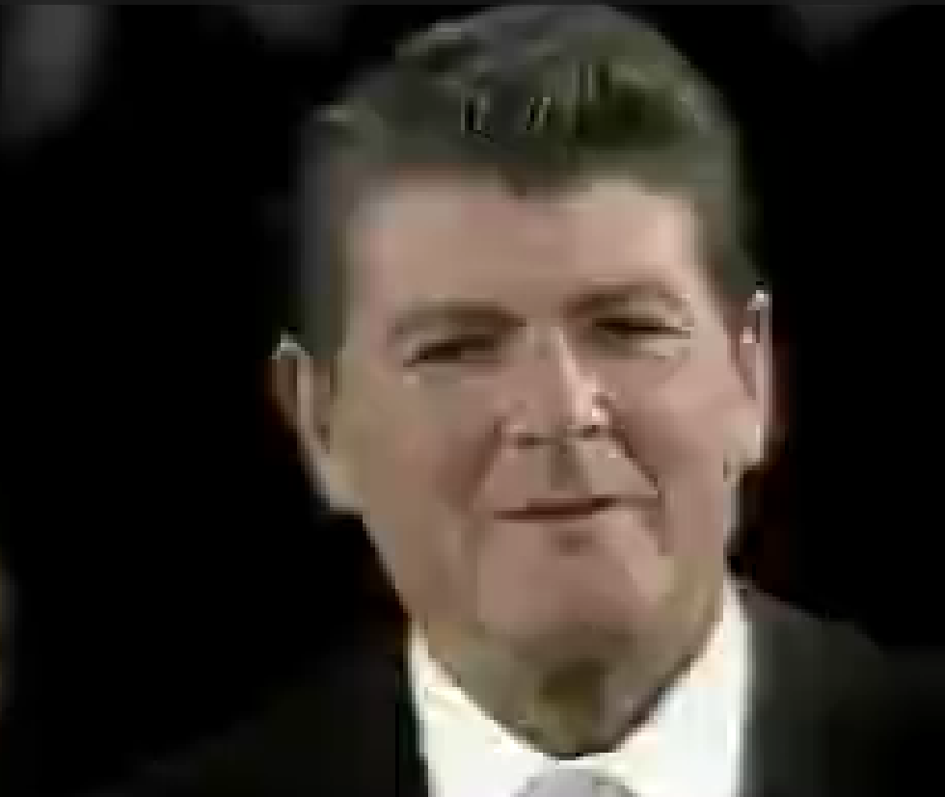
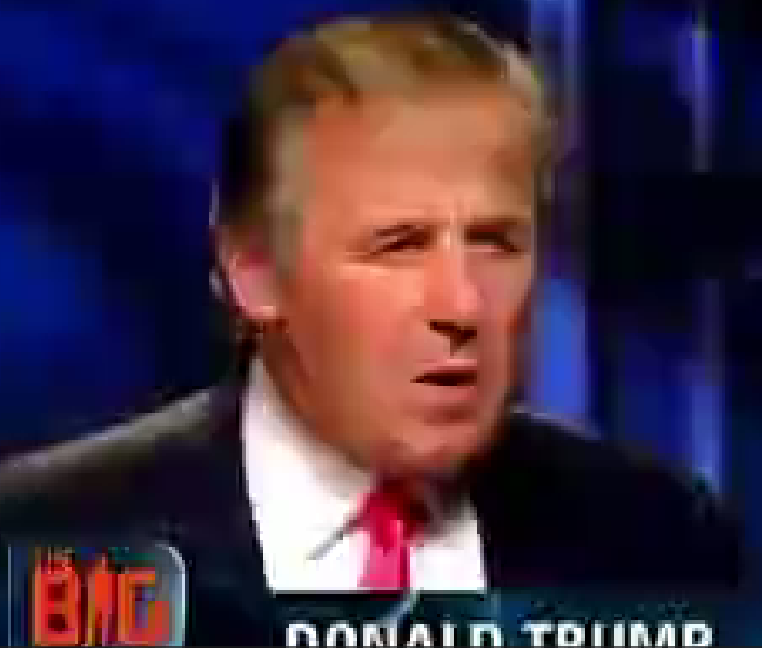
Generate New Data
Generate data
Preprocess models
Train data on CNN & QNN
Generate new data
Test data on CNN & QNN
Developed with Roop method: https://github.com/s0md3v/roop
Replace faces in videos
10 real, 10 fake

Slide 27
Test Data on CNN & QNN
Generate data
Preprocess models
Train data on CNN & QNN
Generate new data
Test data on CNN & QNN
c_test_predictions = c_model.predict(test_images) # Predict probs for test images
# Calculate the test accuracy and loss
test_accuracy = np.mean(c_test_pred_labels.flatten() == test_labels)
c_test_loss, _ = c_model.evaluate(test_images, test_labels, verbose=0)
q_test_predictions = q_model.predict(q_test_images) # Predict probs for test images
# Calculate the test and loss
test_accuracy = np.mean(q_test_pred_labels.flatten() == test_labels)
q_test_loss, _ = q_model.evaluate(q_test_images, test_labels, verbose=0)

Slide 28
Results

Slide 29
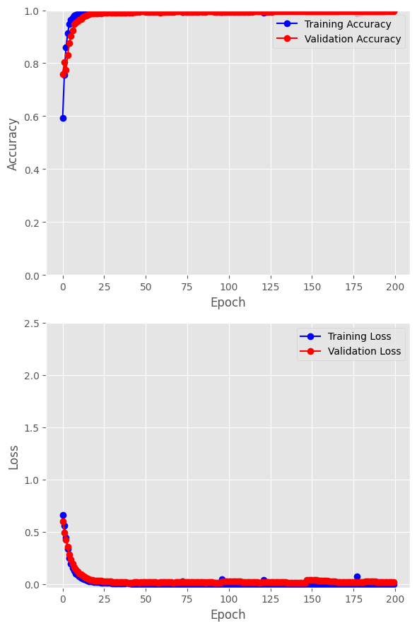
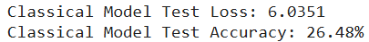
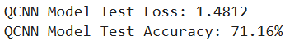

CNN vs. QNN
Loss and Accuracy
vs.
Click the icon to see the hugging demo

Slide 30
References

Slide 31
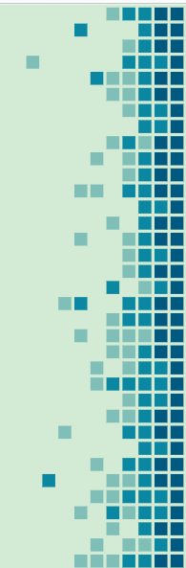
References
Fairfield, J., & Shtein, H. (2014). Big Data, Big Problems: Emerging Issues in the Ethics of Data Science and Journalism. Journal of Mass Media Ethics, 29(1), 38–51. https://doi.org/10.1080/08900523.2014.863126
Fernandes, S., Raj, S., Ewetz, R., Pannu, J. S., Jha, S. K., Ortiz, E., ... & Salter, M. (2020). Detecting deepfake videos using attribution-based confidence metric. In Proceedings of the IEEE/CVF Conference on Computer Vision and Pattern Recognition Workshops (pp. 308-309).
Hand DJ (2018) Aspects of data ethics in a changing world: where are we now? Big Data 6:3, 176–190, DOI: 10.1089/big.2018.0083.
Henderson, M., Shakya, S., Pradhan, S., & Cook, T. (2020). Quanvolutional neural networks: powering image recognition with quantum circuits. Quantum Machine Intelligence, 2(1), 2.
Mari, Andrea. “Quantum Transfer Learning.” PennyLane Demos, November 6, 2024. https://pennylane.ai/qml/demos/tutorial_quantum_transfer_learning.
“What Is a Neural Network?” IBM, October 25, 2024. https://www.ibm.com/topics/neural-networks.
Zafra, Miguel Fernandez. “Understanding Convolutions and Pooling in Neural Networks: A Simple Explanation.” Medium, May 25, 2020. https://towardsdatascience.com/understanding-convolutions-and-pooling-in-neural-networks-a-simple-explanation-885a2d78f211.
Notes:
file:///C:/Users/hanna/Downloads/WiML_2%20(1).pdf

Slide 32
Thank You!

